Slide 1
OpenAEC Foundation
Build free. Build together.
Mei 2026 update — Delft, 2026

Slide 2
COMPANY
3BM
(Structural) Engineering
Architectural and engineering firm. The practice where it all started.
3bm.co.nl

Slide 3
COMPANY
Domera
Floating Home builders & developers
Floating home builders and developers.
domera.nl

Slide 4

COMPANY
Impertio
Implementation & deployment
From bare PC to AI workstation. Open source ecosystem deployment.
impertio.nl

Slide 5

CONCEPT
OpenCompany246
Fully open source business
246 business processes covered with open source tools.
opencompany246.nl

Slide 6
01 — CONTEXT
The problem
$$$$
Closed data
Islands
Vendor-driven
Not possible
License costs
Vendor lock-in
Fragmentation
No innovation
AI integration

Slide 7
02 — MISSION
The OpenAEC Foundation
Open source software for the entire construction chain
Founded March 1, 2026 — Dordrecht, NL — Inspired by the Blender Foundation
Development
Support
Coordinate and fund open source software
Licenses, API connections and integrations
Education
Advocacy
Internship and training opportunities worldwide
Promote open source and open standards

Slide 8
03 — ECOSYSTEM
The open source stack
Design
Blender + Bonsai FreeCAD Open 2D Studio building.py
Collaboration
Nextcloud OpenAEC Docs IfcGit Speckle
Engineering
Energy Studio Heatloss Calc Studio BIM Validator FEM2D
Business
ERPNext Invoicing HRM Planning
AI
Claude / LLM's MCP Servers Open Agents Speech Studio

Slide 9
04 — PARTNERS
OpenCompany246 & Impertio
What
How
Software
OpenCompany246
→
Impertio
→
OpenAEC Foundation
246 business processes covered with open source
Implementation, deployment & training
Development & maintenance

Slide 10
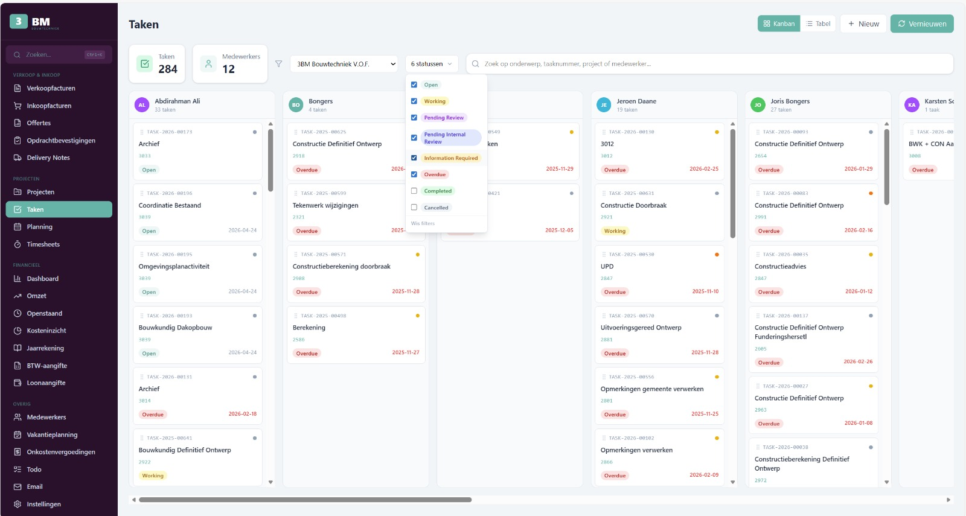
05 — ERP
ERPNext
Open source ERP for construction
Project management · Invoicing & accounting · HRM — NL payroll · Dashboard App · Level Dashboard

Slide 11
06 — BIM
Blender & Bonsai — Open BIM
Blender + Bonsai
building.py
Sverchok
Claude Skills
IFC authoring
Code-based buildings
Visual programming
AI-assisted design

Slide 12
07 — COLLABORATION
Nextcloud
File management
IfcGit
Check-in/out
Claude Bot
Version control
IFC versioning
Vault-like
AI in Talk

Slide 13
08 — NUMBERS
By the numbers
101
52
416
4228
5807
Repositories
Public
Stars
Total commits
Total downloads
Top releases | Rel. | Version
open-pdf-studio | 48 | v1.47.3
open-2d-studio | 25 | v0.35.0
Open-Calculations-Studio | 11 | v0.1.4
open-calc-studio | 11 | v0.7.8
open-geotechniek-studio | 4 | v0.2.9
Top commits | Commits
building-py | 764
open-heatloss-studio | 485
open-pdf-studio | 450
Open-Agents | 322
openaec-reports | 235

Slide 14
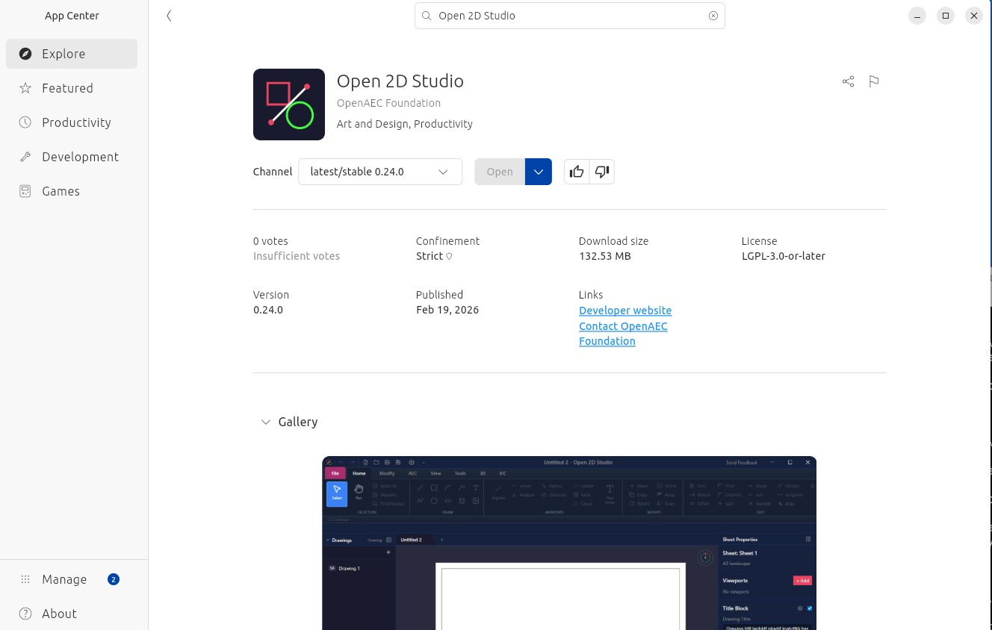
22 RELEASES
Open 2D Studio
2D viewer and drawing environment
View, annotate and edit 2D drawings. Extension system.
90 commits · v0.35.0 · TypeScript

Slide 15
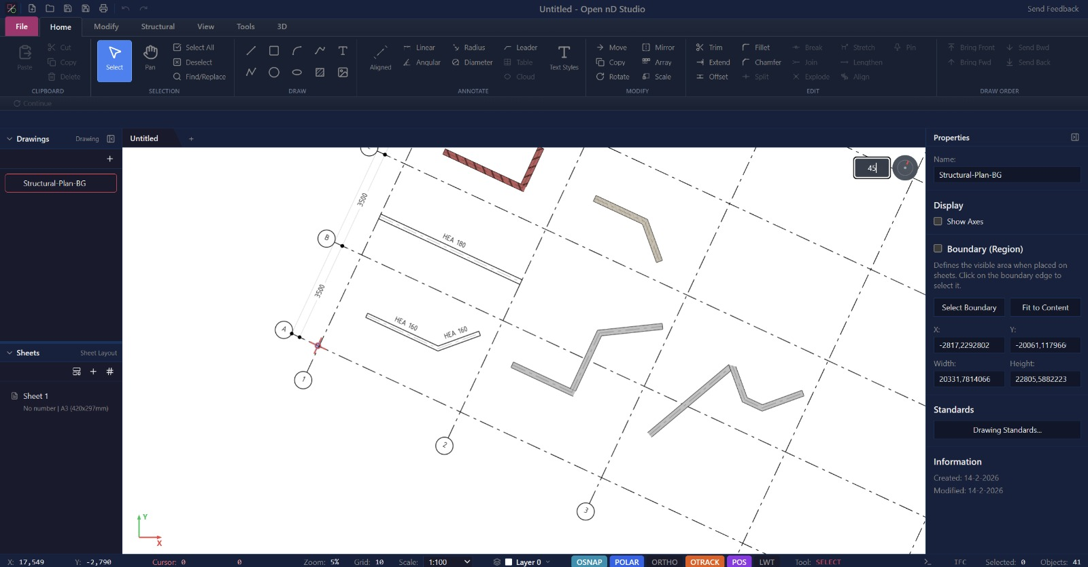
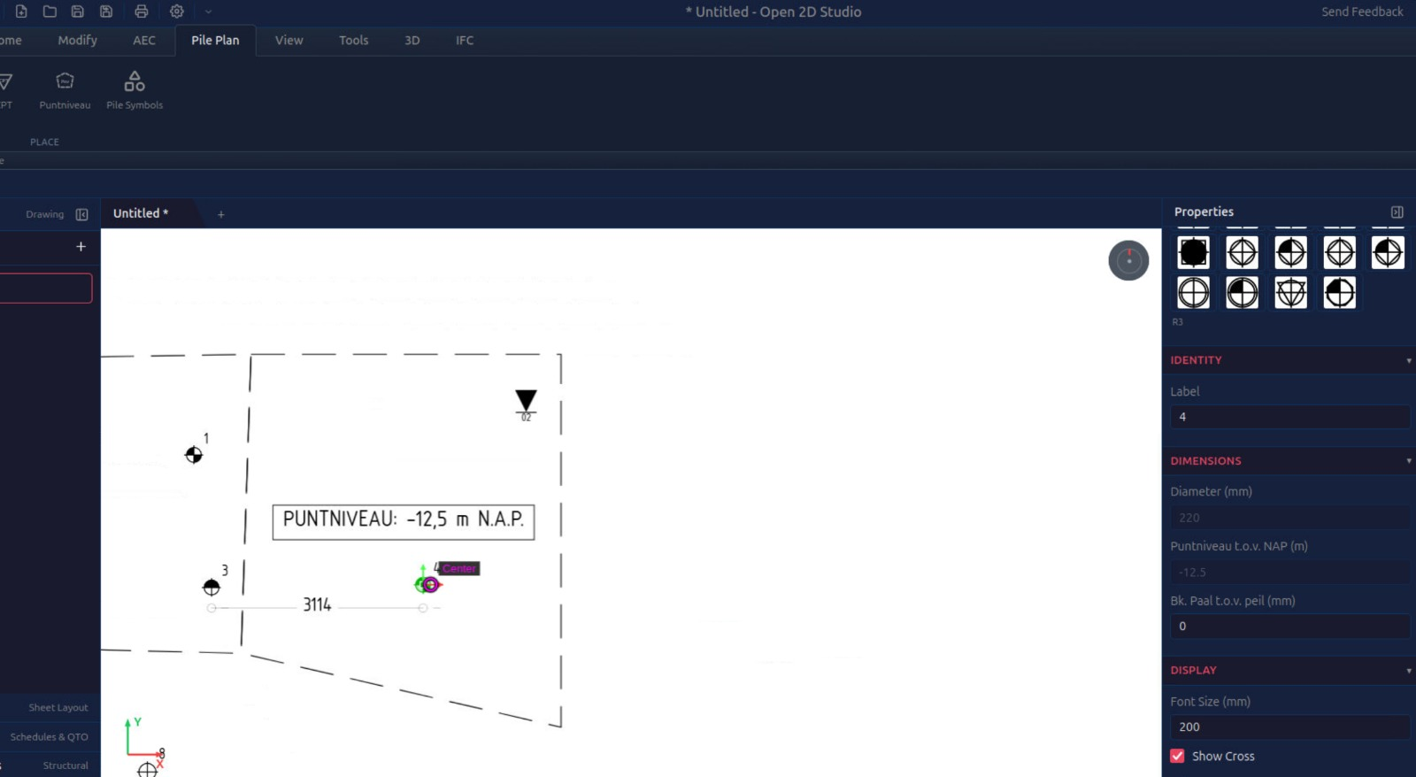
EXTENSION
2D Studio AEC Extension
AEC functionality
Construction symbols, layers and annotations.
7 commits · v0.1.0

Slide 16
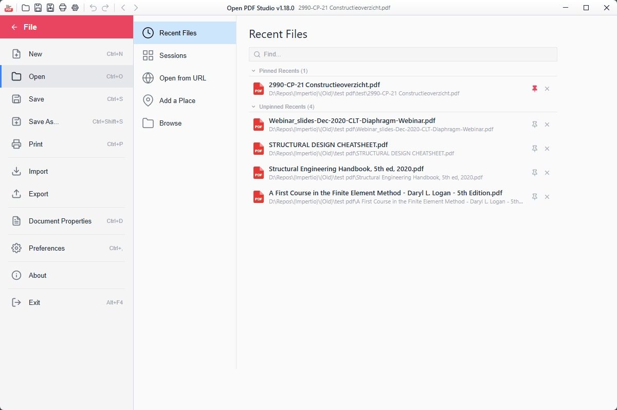
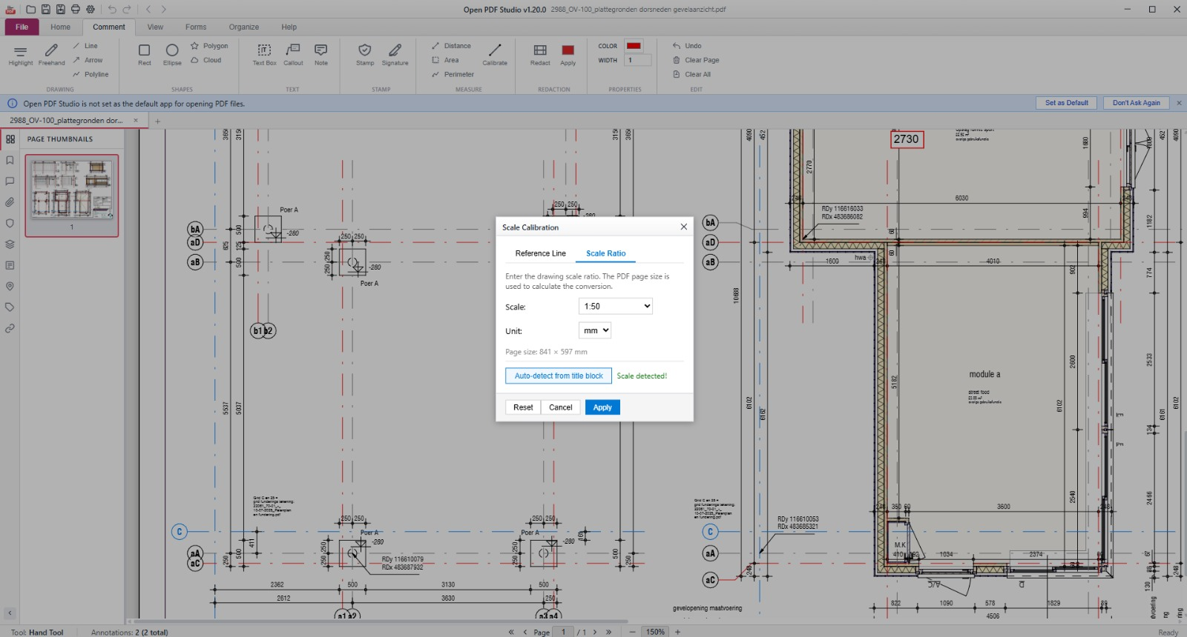
48 RELEASES
Open PDF Studio
PDF document workflows
View, combine and edit PDFs for construction.
450 commits · v1.47.3

Slide 17
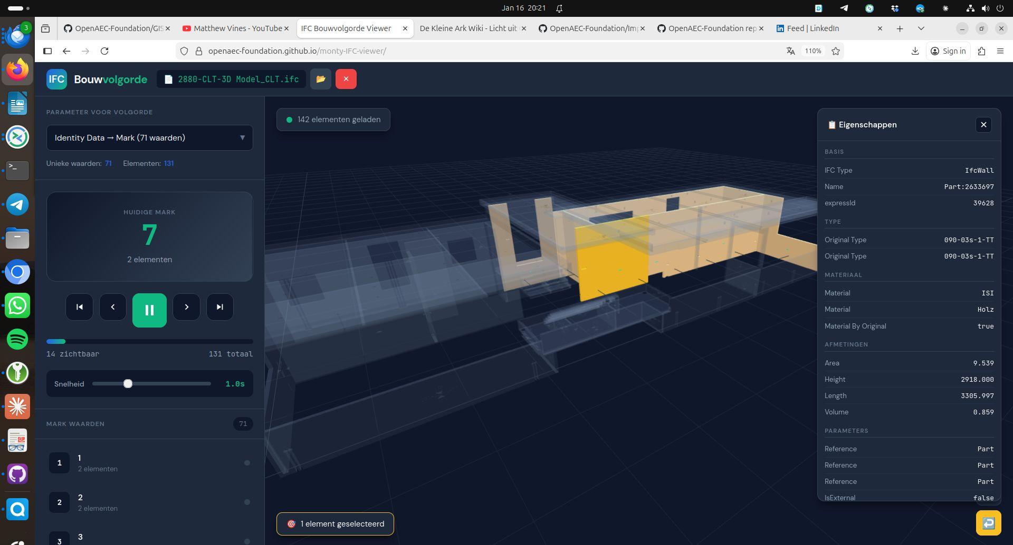
2 RELEASES
Monty IFC Viewer
Lightweight IFC viewer
Web-based BIM viewer with Three.js.
45 commits · v1.0.1

Slide 18
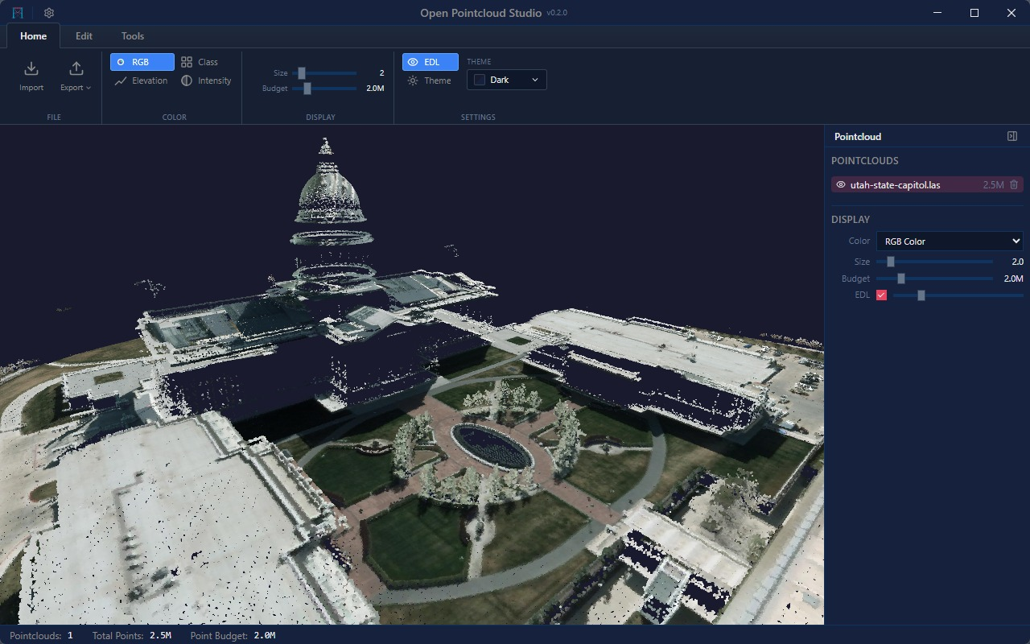
2 RELEASES
Open Pointcloud Studio
Point clouds
View and edit point clouds.
12 commits · v0.3.0

Slide 19
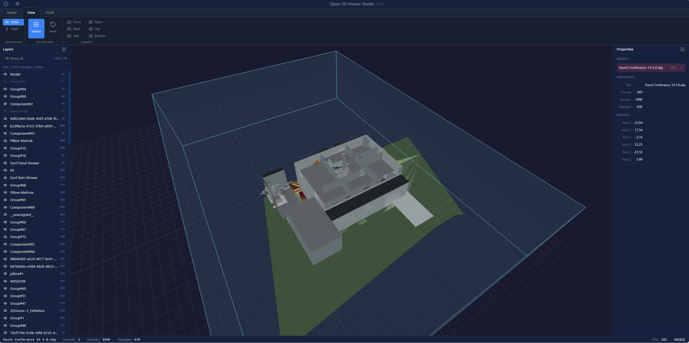
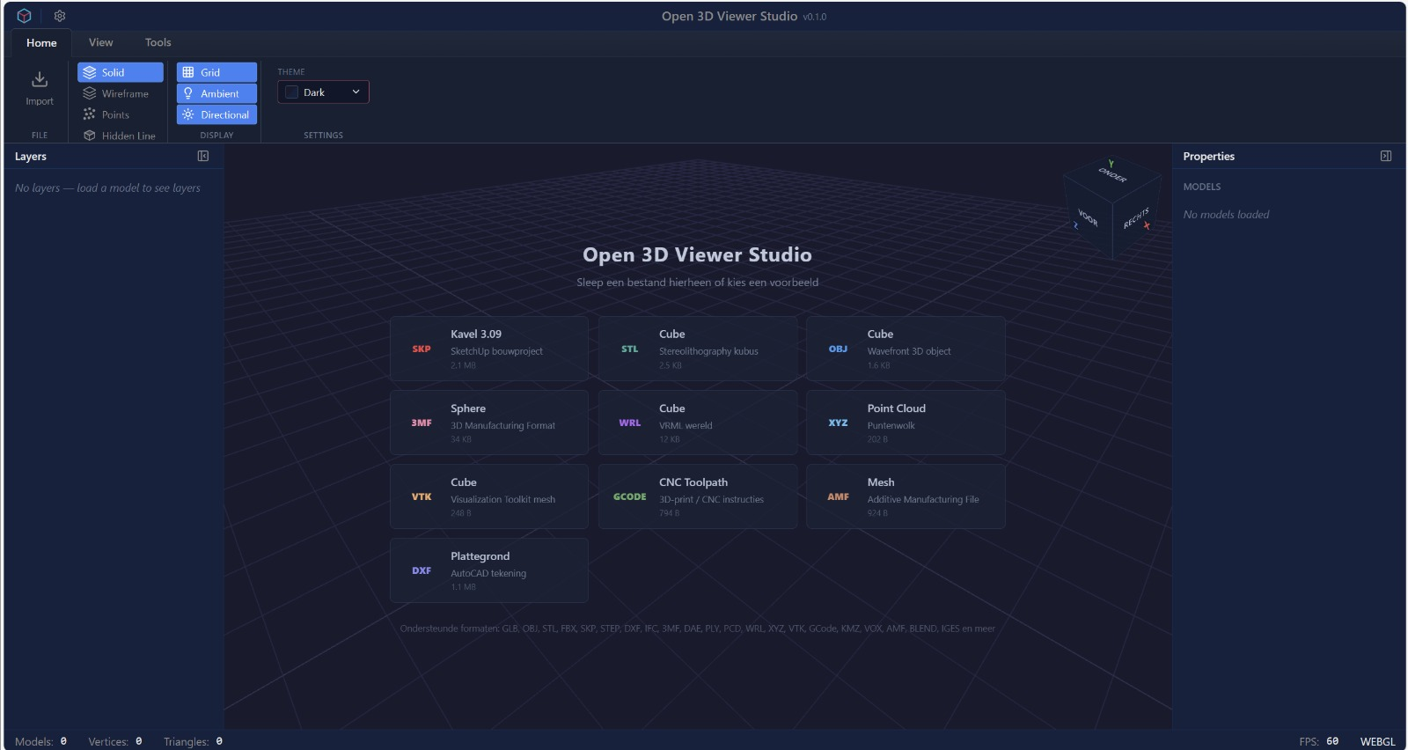
ALPHA
Open 3D Viewer
3D viewer
Universal 3D viewer in the browser.
7 commits · v0.1.0-alpha

Slide 20
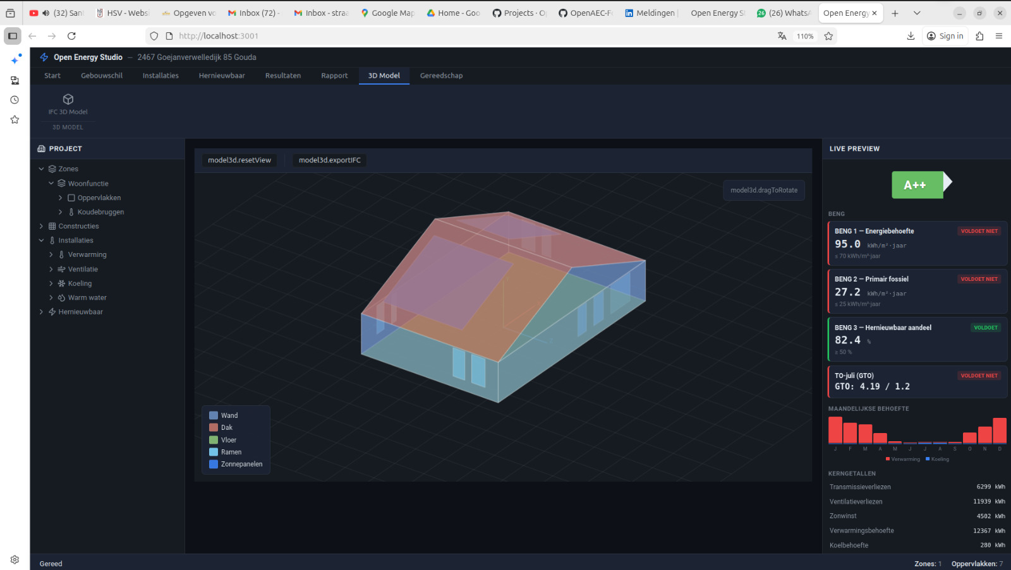
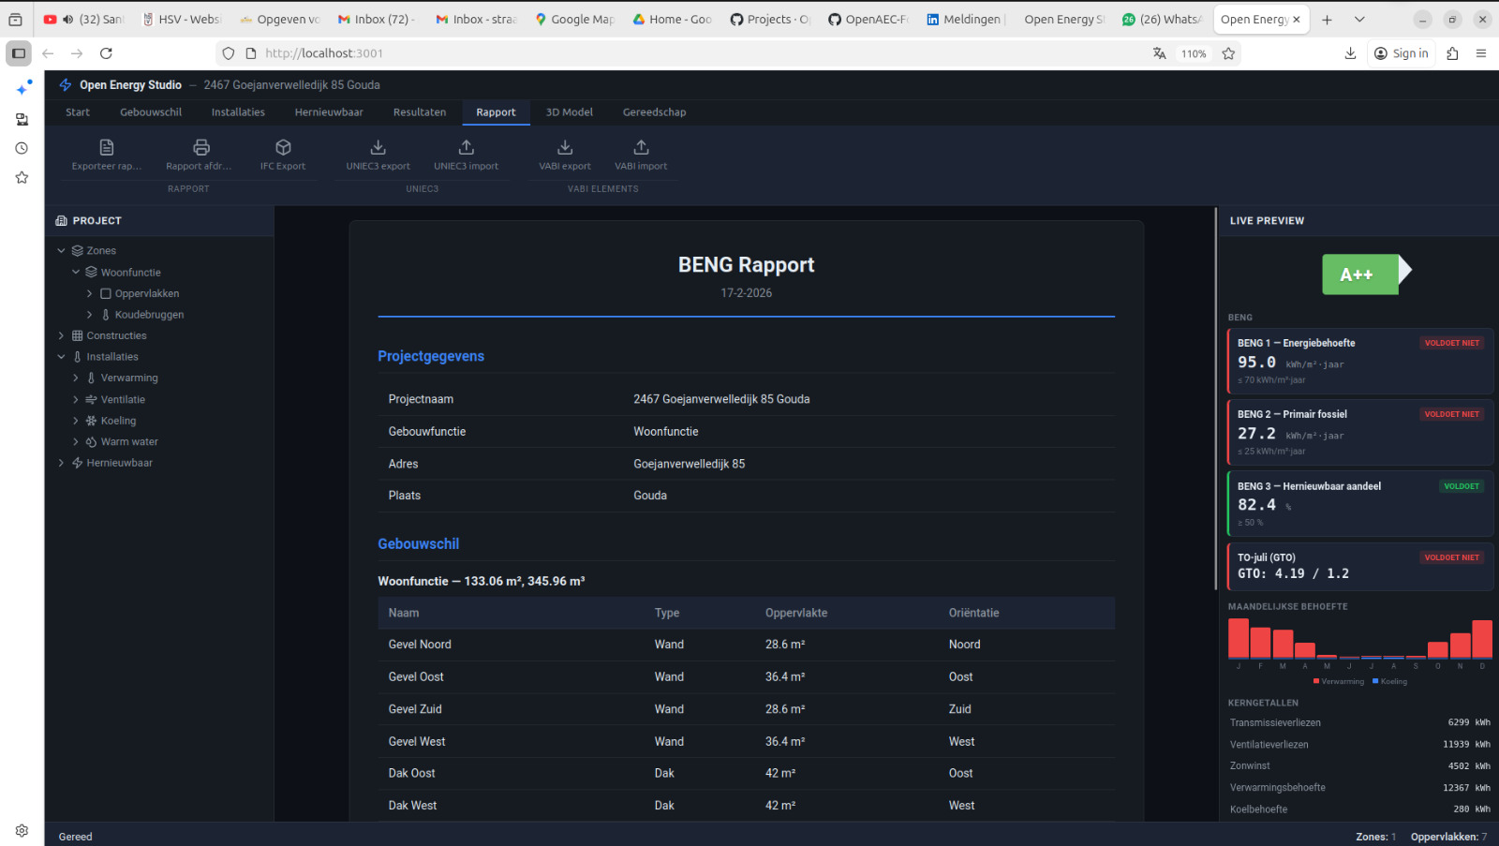
1 RELEASE
Open Energy Studio
Energy performance NTA 8800
Desktop app with Tauri 2.
11 commits · v2026.2.0

Slide 21
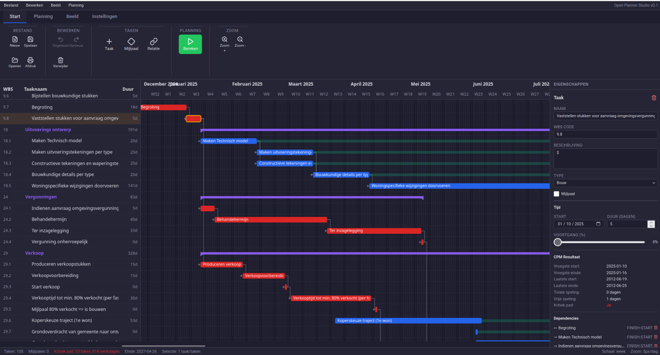
1 RELEASE
Open Planner Studio
Project planning
Gantt charts with Tauri 2.
10 commits · v2026.2.0

Slide 22
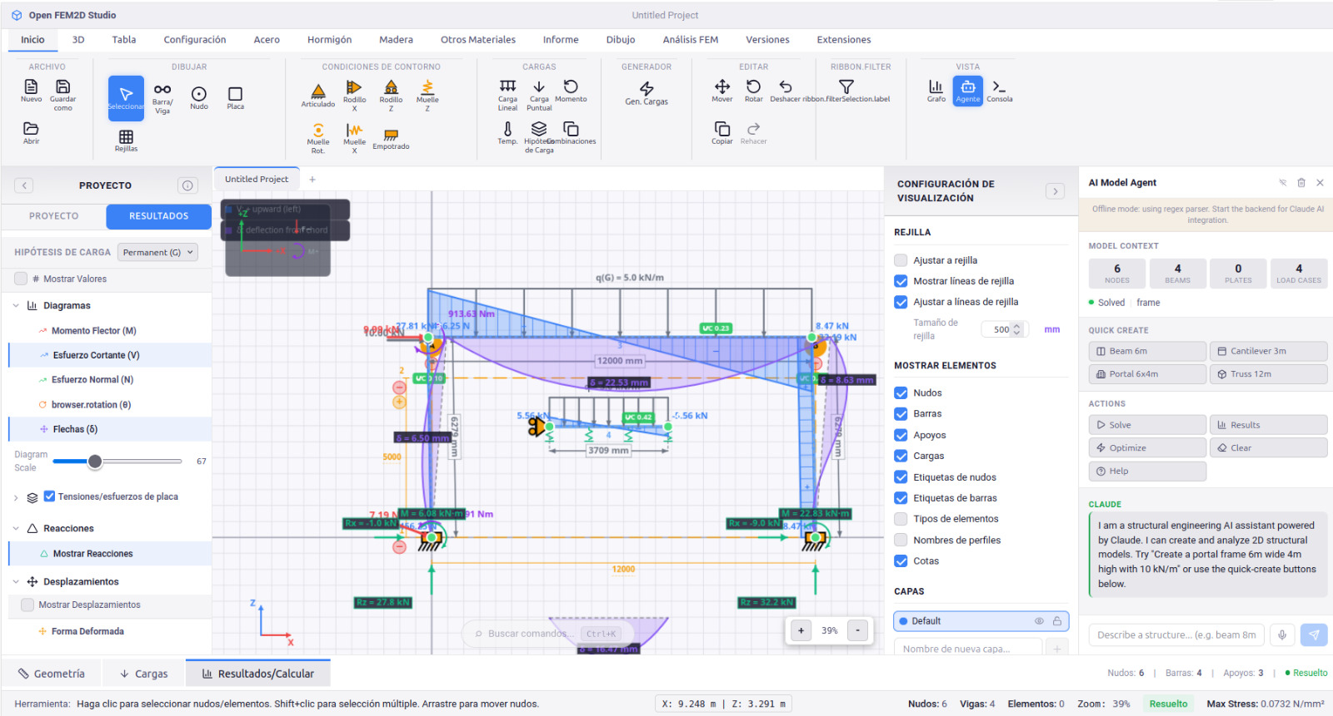
TOOL
Open Frame Studio
2D structural frame analysis
For buildings and civil load-bearing structures.
29 commits · v0.2.0 · Rust

Slide 23
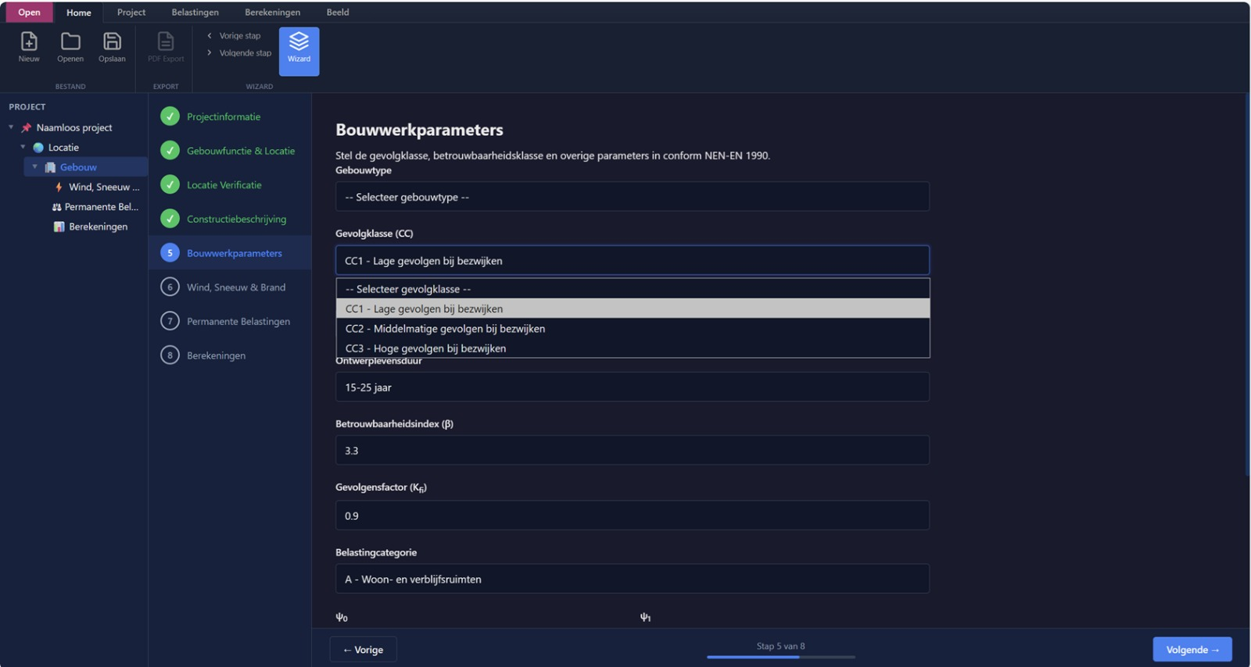
NEW
Structural Engineer Studio
Structural design
Tool for the structural engineer.
1 commit

Slide 24
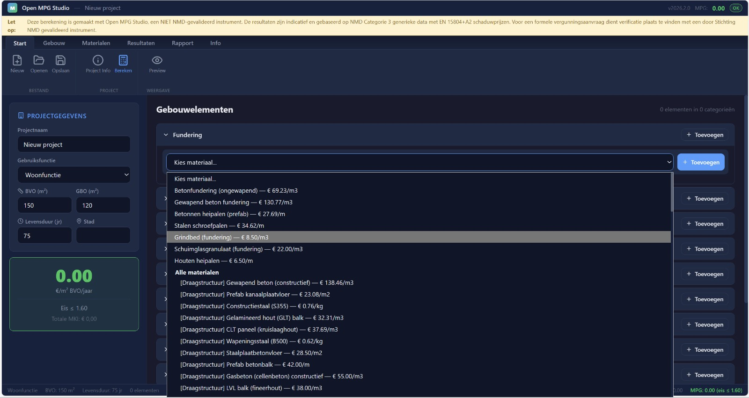
NEW
Open MPG Studio
Environmental performance
MPG calculation for building permits.
2 commits

Slide 25
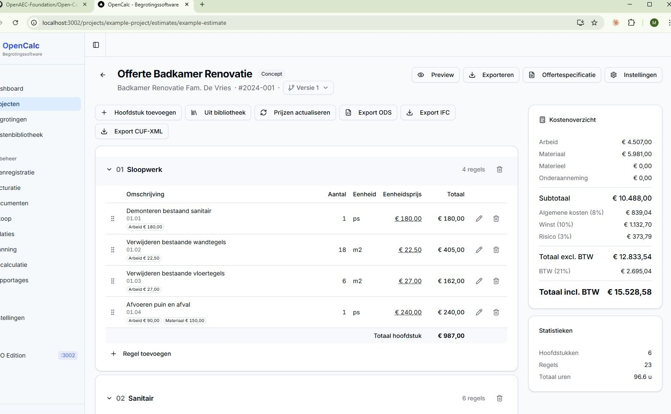
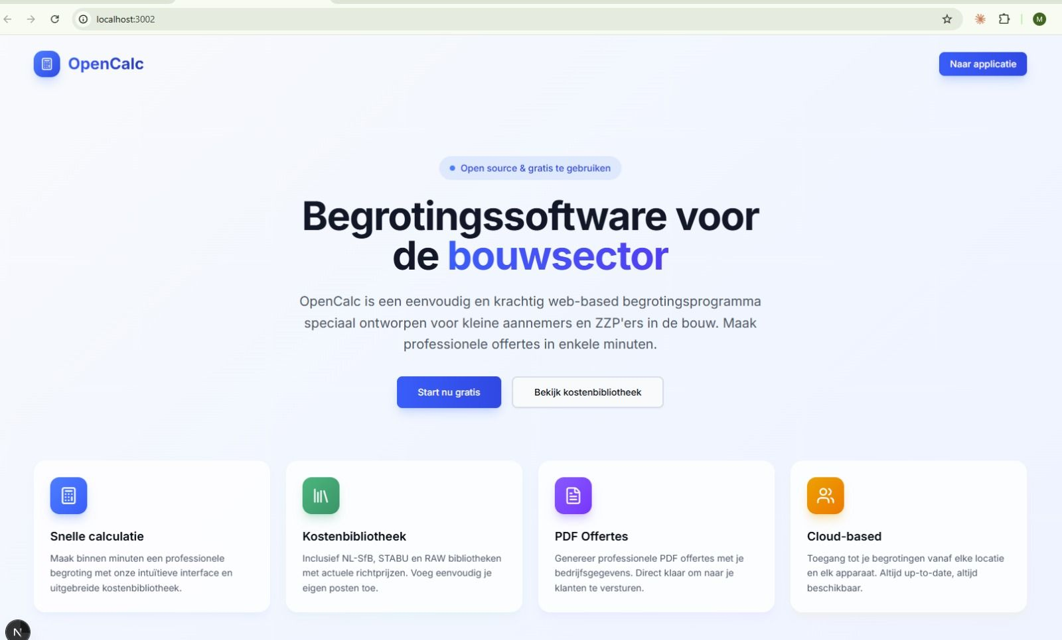
NEW
Open Calc Studio
Calculation tool
Cost estimation for buildings, civil & infra.
6 commits · v0.7.8

Slide 26
LIBRARY
Heat loss calculation
ISSO 51:2023
Rust calculation library.
21 commits · Rust

Slide 27
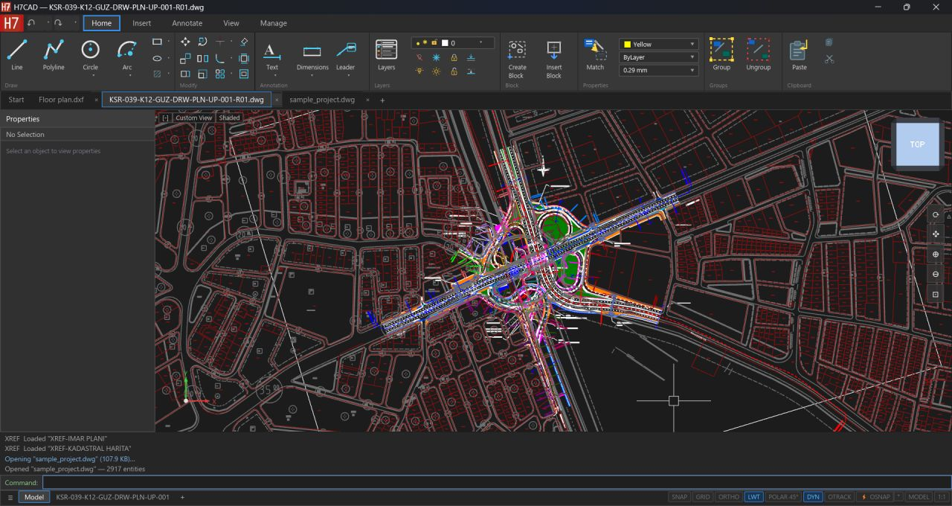
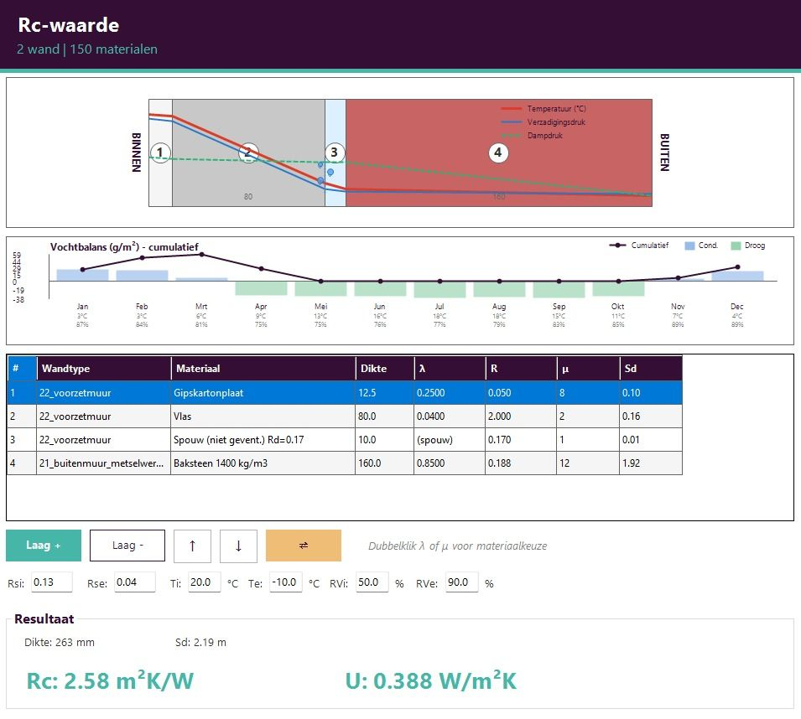
COMMUNITY
Open CAD Studio
Native DWG/DXF in Rust
Community project (Hakan Seven). 514 commits, v0.4.1, 28 stars.

Slide 28
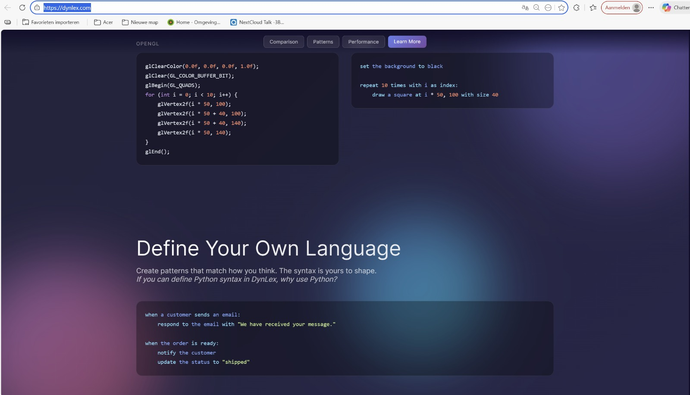
98 COMMITS
Dynlex
C++ calculation engine
High-performance calculation tool.
98 commits · C++

Slide 29
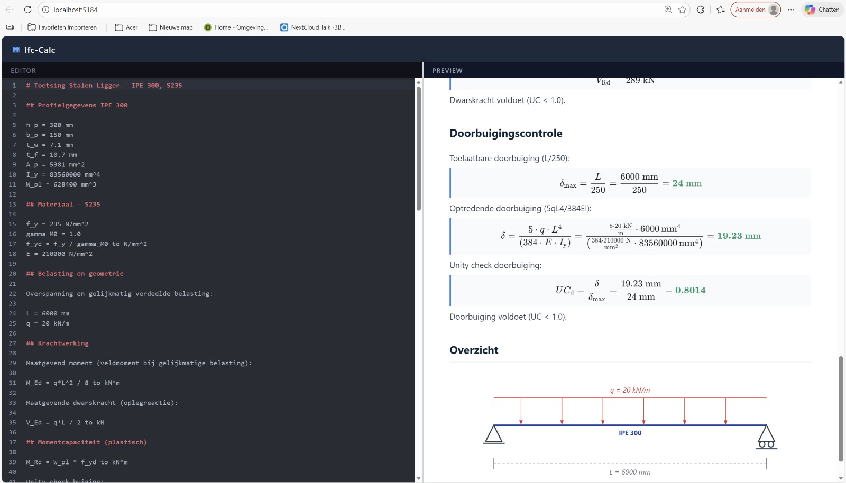
TOOL
Ifc-Calc
Graphical calculator
Calculations linked to IFC models.
3 commits

Slide 30
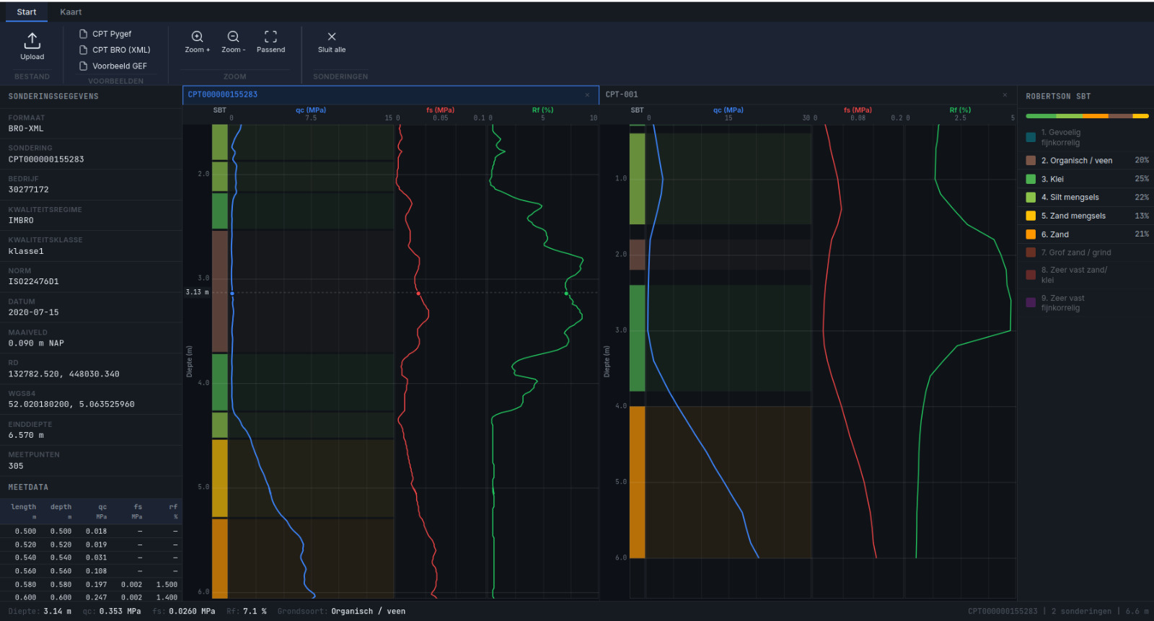
108 COMMITS
Open Geotechniek
Sonderingen & boringen (NL geotechniek)
GEF + BRO-XML, Robertson SBT, Kadaster-overlays, .ifcgis.
108 commits · v0.2.9 · Rust + TS

Slide 31
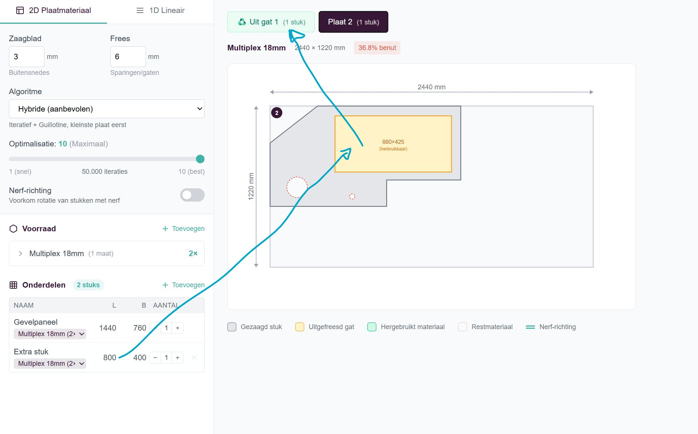
TOOL
Cutlist Optimizer
Cut plan optimization
1D and 2D materials.
JavaScript

Slide 32
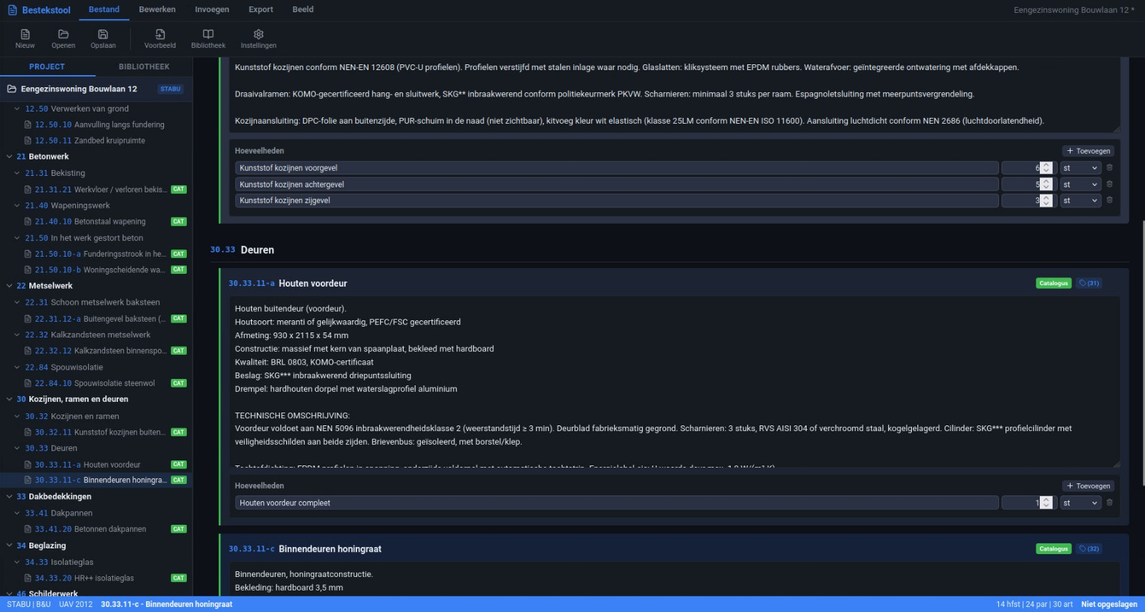
NEW
Bestekstool
Specifications writing
Specifications for construction projects.

Slide 33
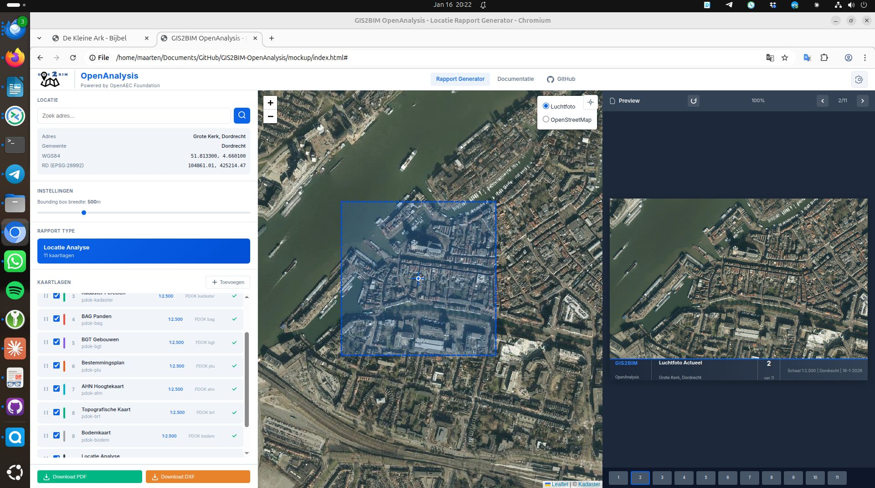
764 COMMITS
building.py
Python building modeling
Export to Blender, Revit, IFC, DXF, Speckle.
v0.1-beta · Python

Slide 34
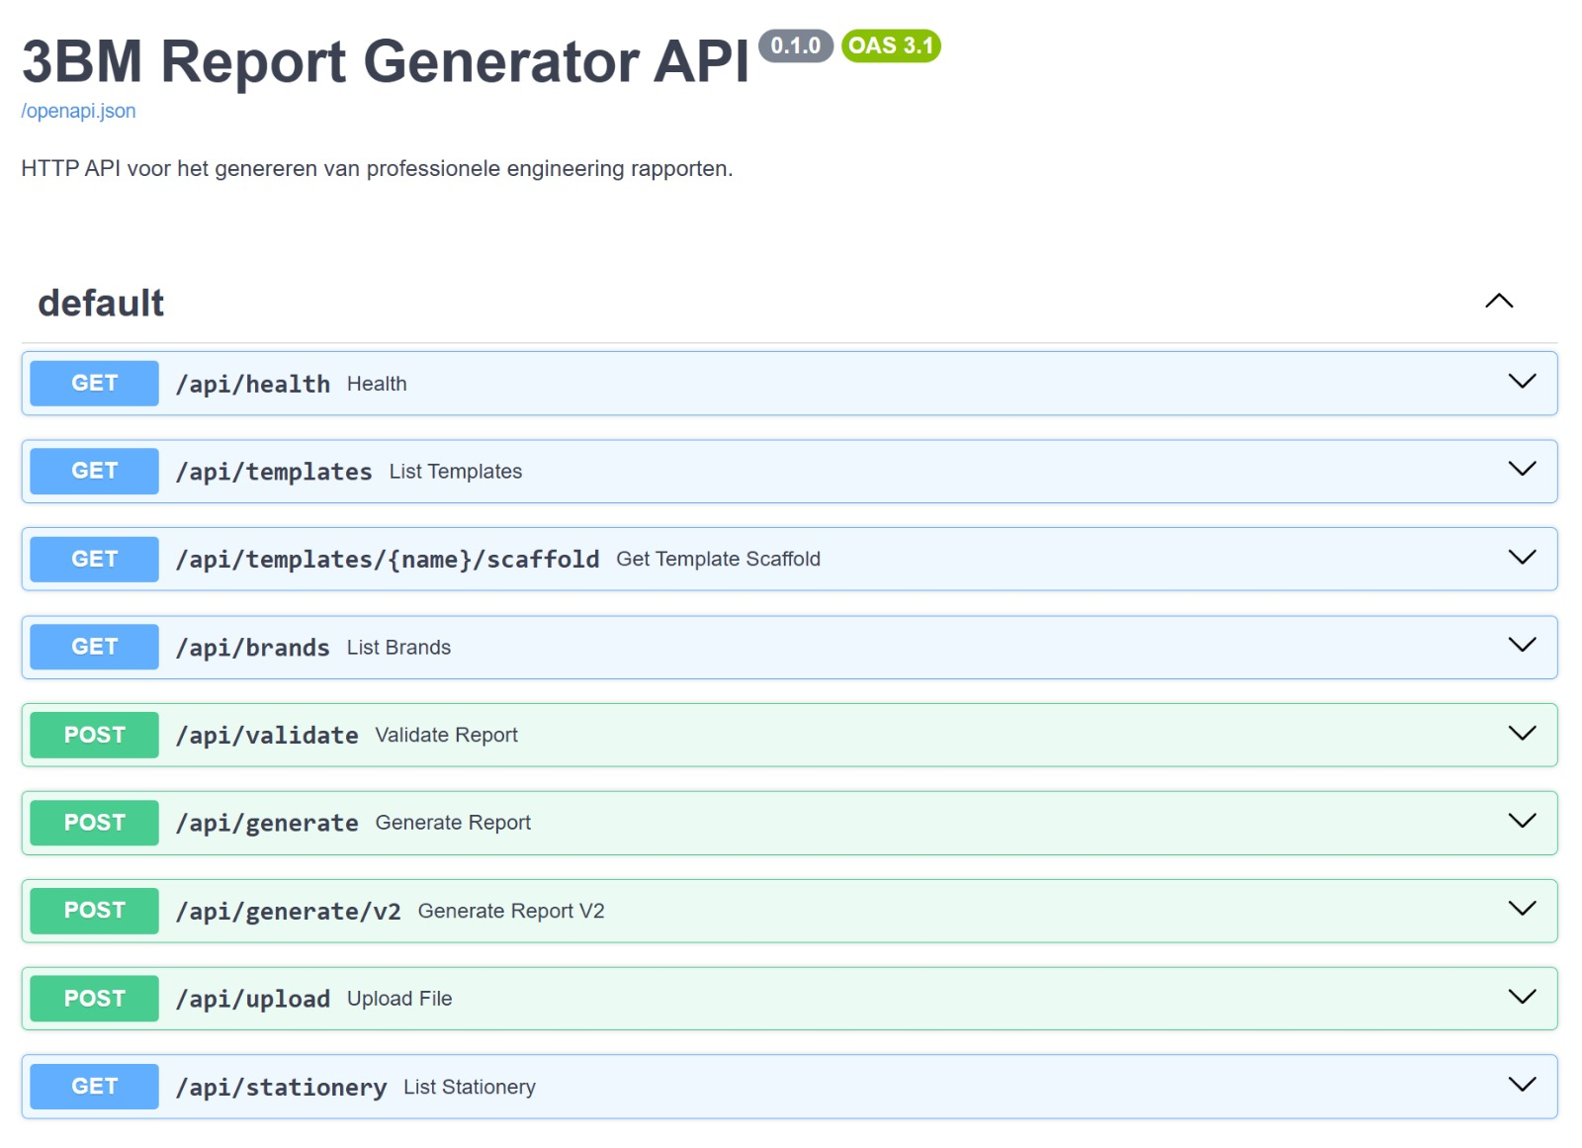
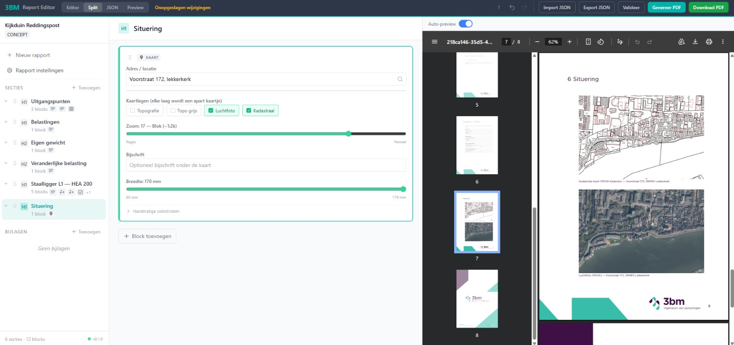
131 COMMITS
OpenAEC Reports
Reporting
Generate reports for construction projects.
Python

Slide 35
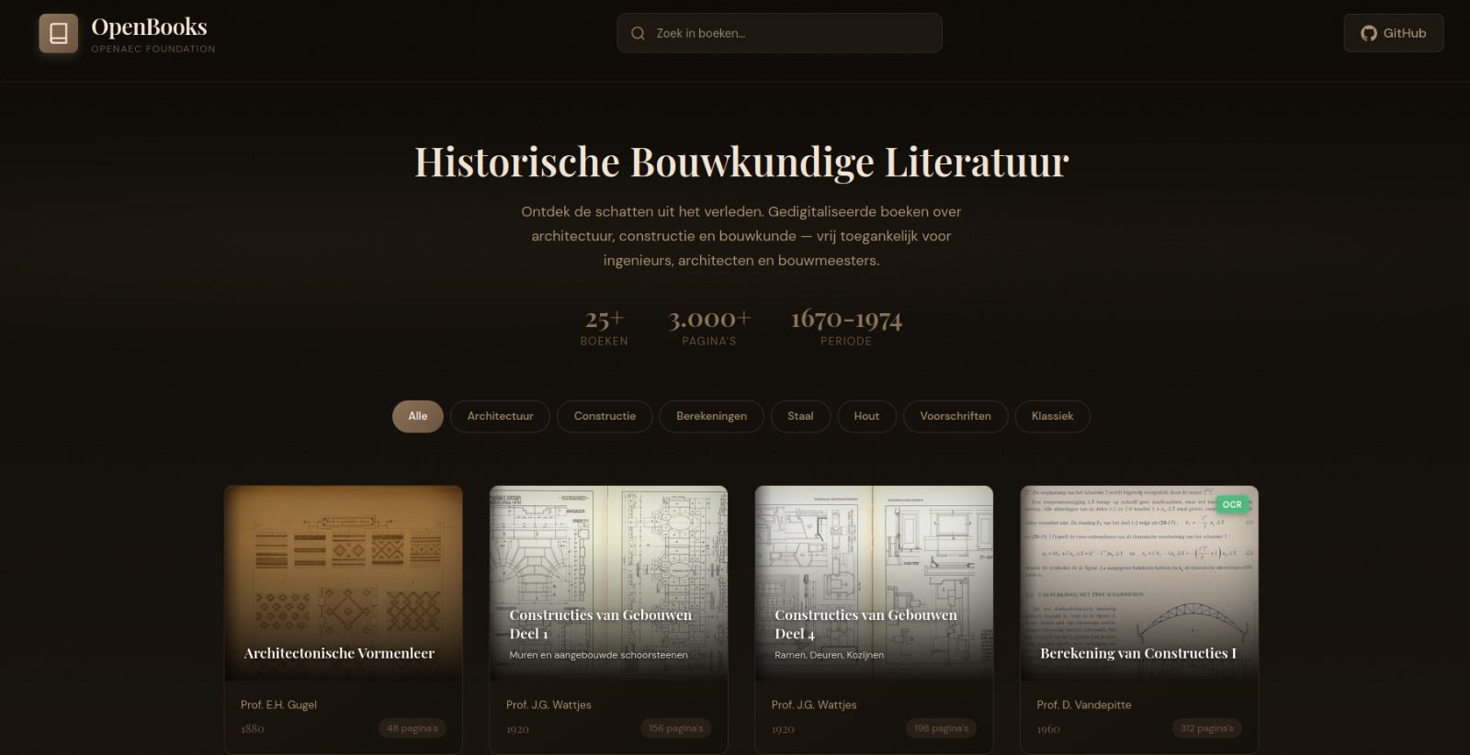
109 COMMITS
Open Books
Historical construction books
Digital collection. Knowledge preservation.

Slide 36
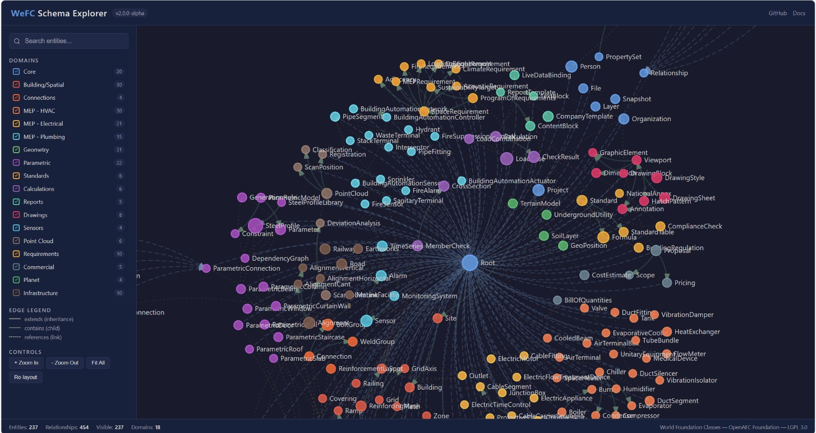
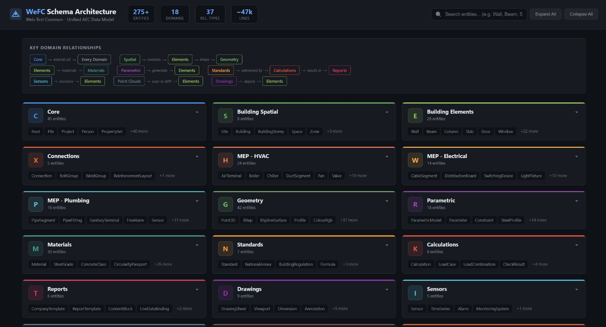
EXPERIMENT
WFC5
IFC5 extension
Complete BIM model in one format.
TypeSpec

Slide 37
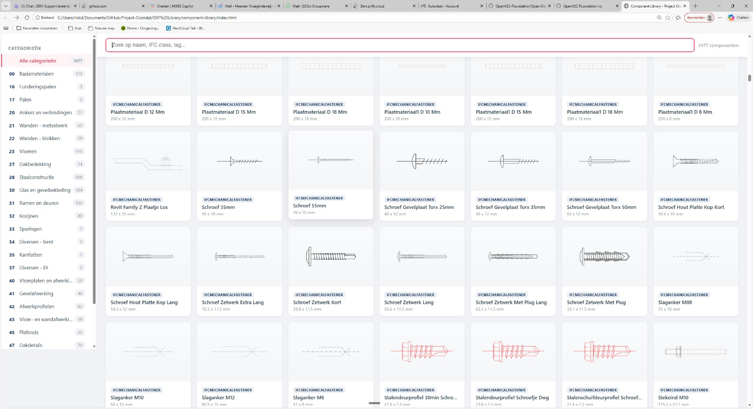
152 COMMITS
Project Ocondat
Open building data
WikiData linked to building information.

Slide 38
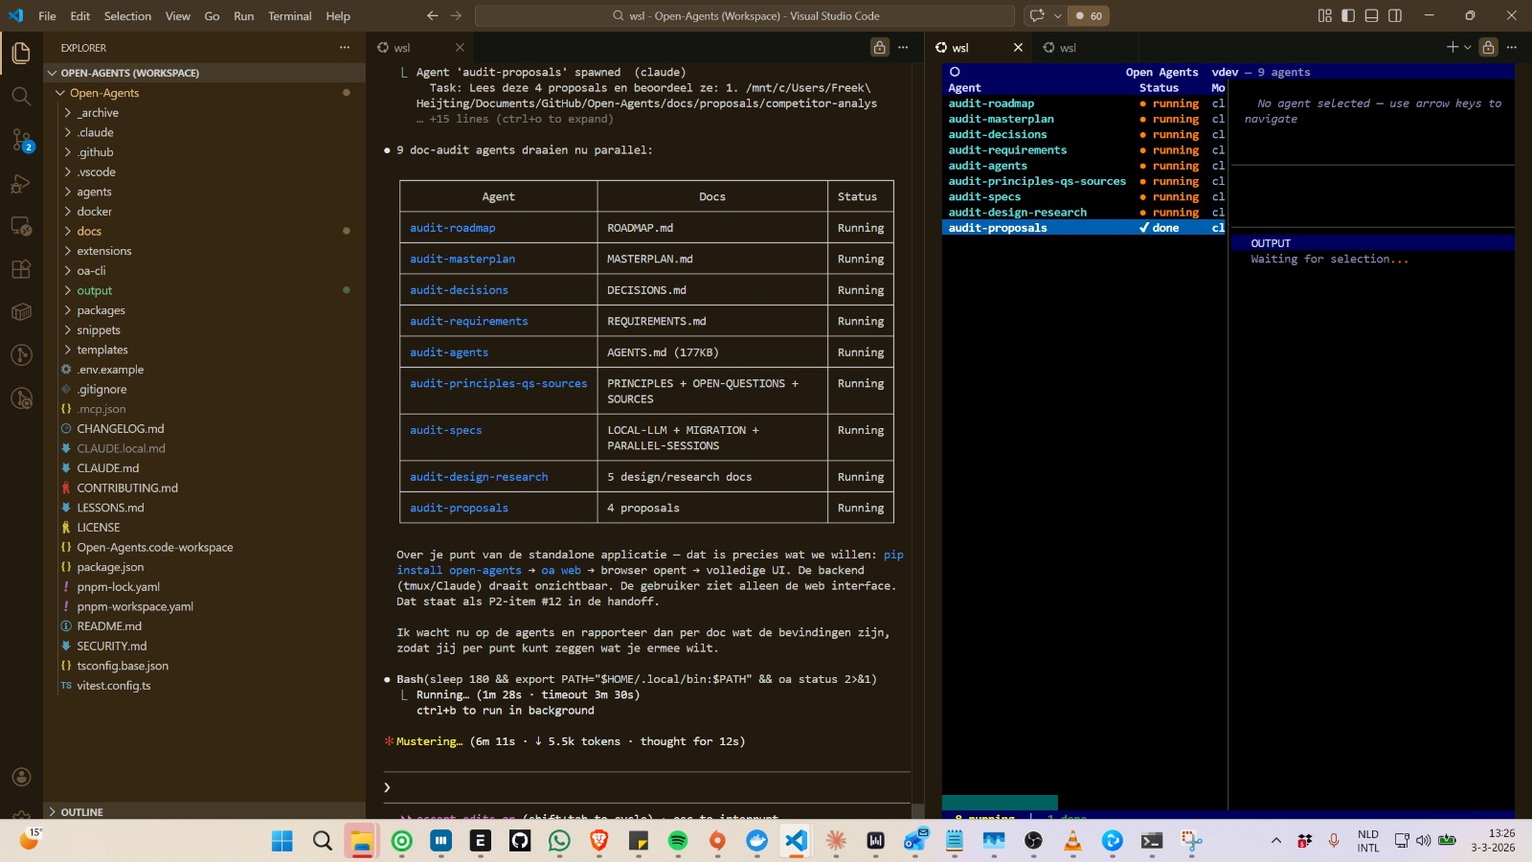
AI — 84 COMMITS
Open Agents
Multi-agent orchestrator
AI agents in parallel via CLI.
TypeScript

Slide 39
ERP
ERPNext Dashboard
Electron desktop app
Banking, invoicing, expense management.
16 commits

Slide 40
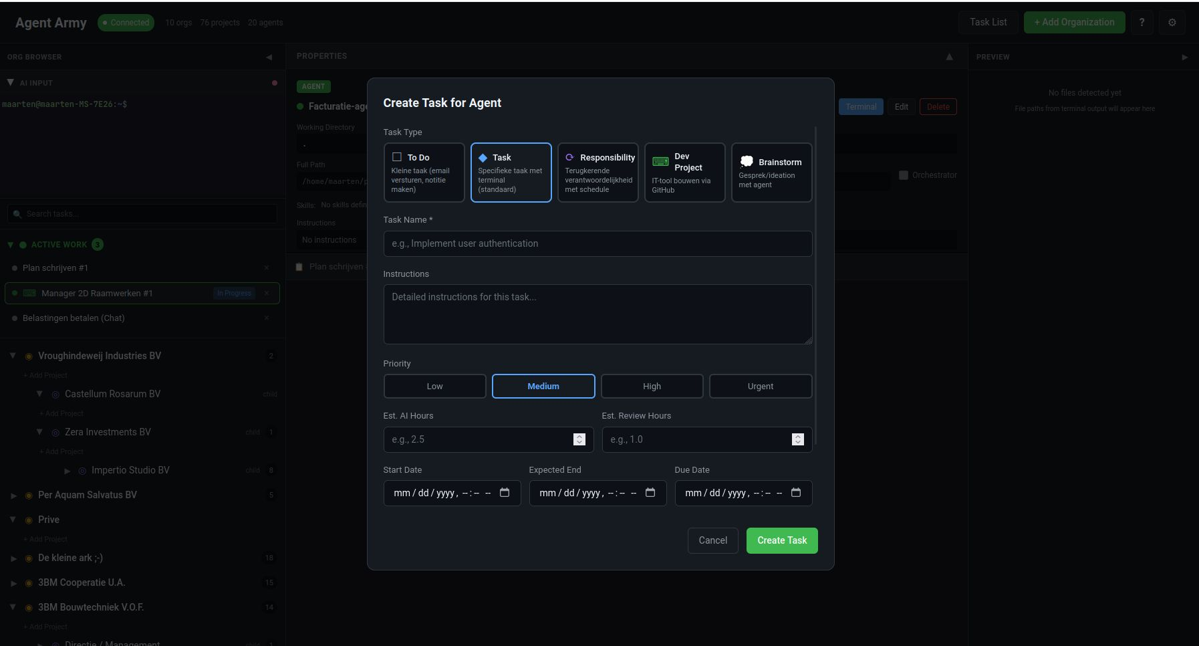
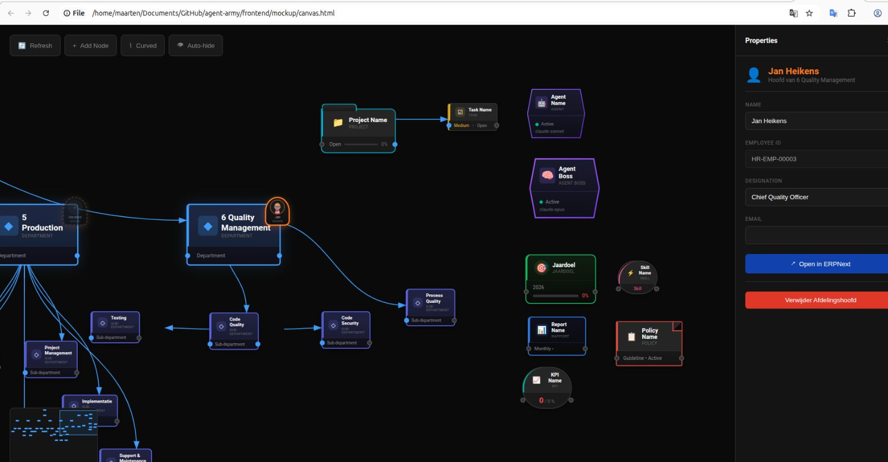
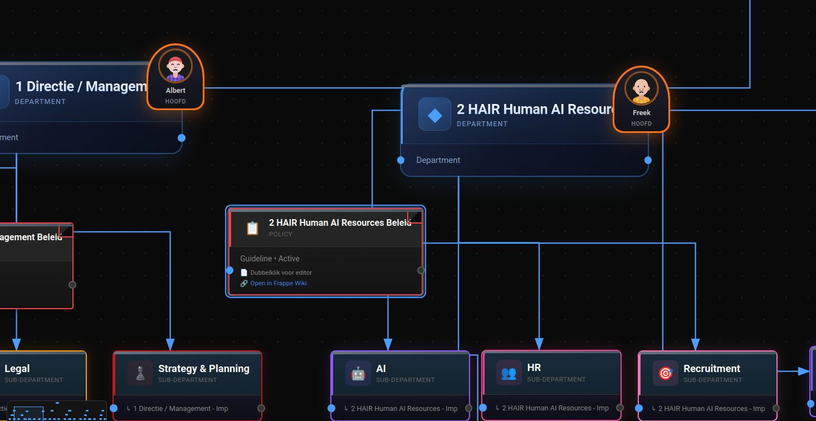
ERP
ERPNext Level Dashboard
Alternative GUI
Departments, employees, AI bots.

Slide 41
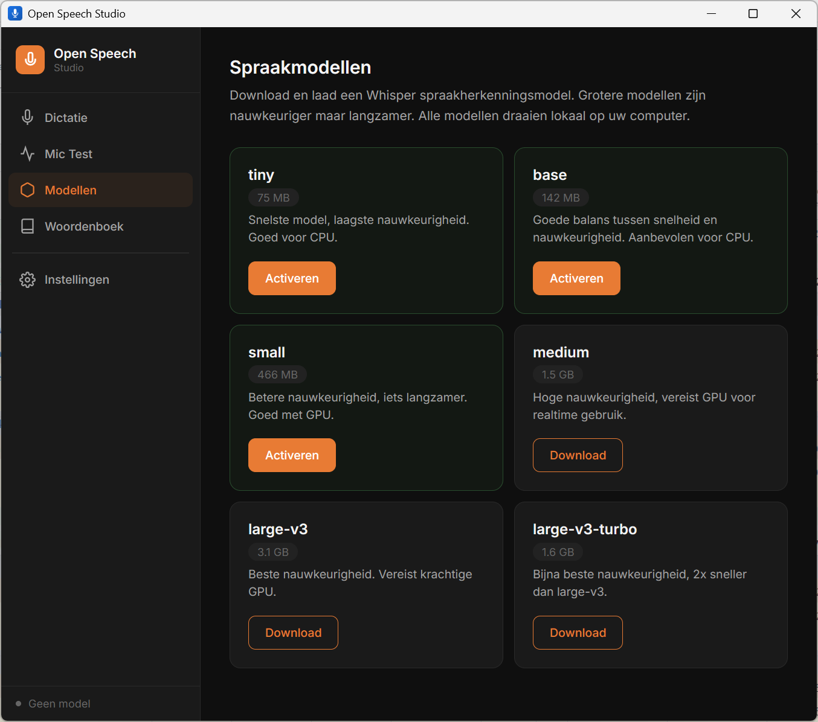
BETA
Open Speech Studio
Speech-to-text with local AI
Dictation, transcription and meeting recording. Powered by OpenAI Whisper. GPU acceleration.
77 commits · v0.9.0 · Tauri 2 + Rust

Slide 42
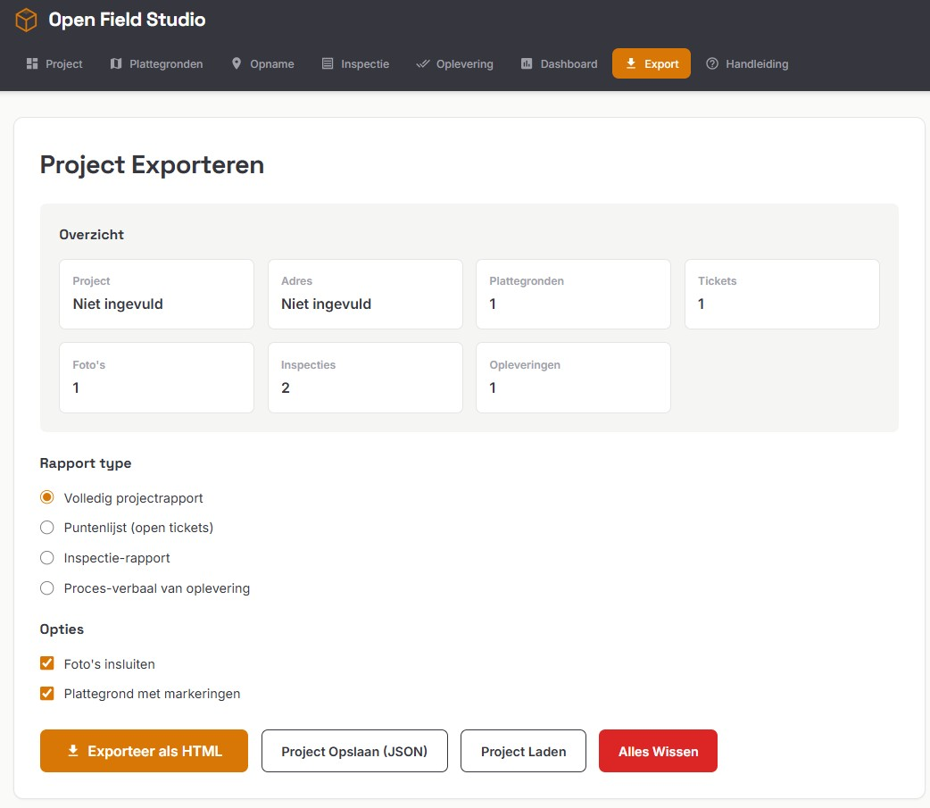
BETA
Open Field Studio
Inspection and quality assurance
Construction site inspections. 15 NEN 2767 checklists. Energy label recording. Offline-capable.
v0.1.3 · Beta · PWA

Slide 43
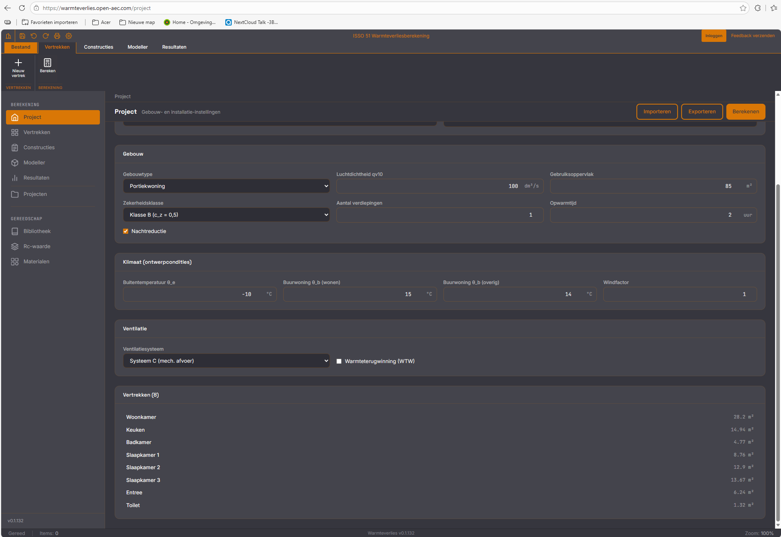
BETA
Open Heatloss Studio
Heat loss calculation NEN 12831
Transmission and ventilation loss calculations. IFCX coupling. Dutch building regulations.
485 commits · v0.1.1-alpha · Rust + TS

Slide 44
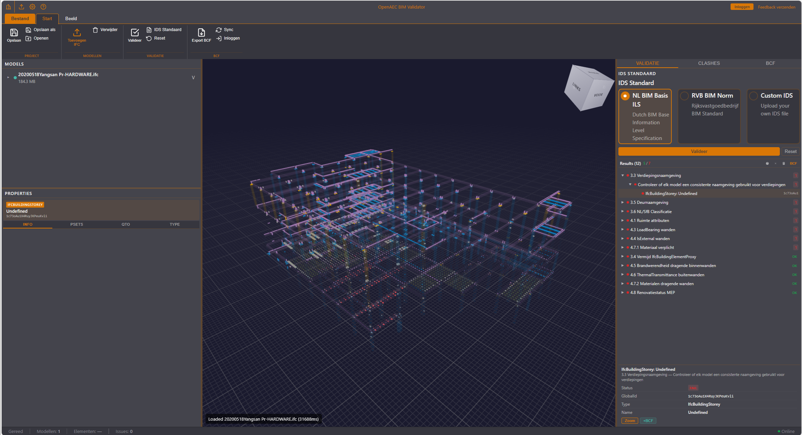
LIVE
BIM Validator
IFC validation against IDS
Validate IFC models against IDS specifications. NL BIM Basis ILS. RVB BIM Norm. BCF export.
Three.js · TypeScript

Slide 45
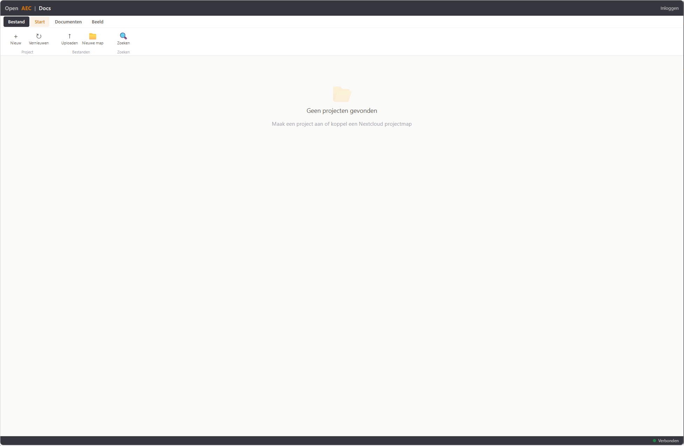
BETA
OpenAEC Docs
BIM document management
Nextcloud-based document management. Version control. IFCX coupling. Full-text search.
Nextcloud · Docker · PostgreSQL

Slide 46
09 - PRICING
Pricing model
Software is en blijft 100% open source. Wij rekenen alleen voor diensten rondom de tools.
01
02
03
SLA
AI
Hosting
Service Level Agreement
Intelligente automatisering
Managed cloud-infrastructuur
- NL-business-hours support
- 4u-respons op P1
- Volgende-werkdag op P2-P3
- On-site training & onboarding
- Vaste support-engineer
- Claude / GPT-credits inbegrepen
- MCP-servers per tool aangesloten
- Copilots in de UI
- Whisper-transcriptie (cloud + GPU)
- Bring-your-own-model toegestaan
- EU-datacenter (NL/DE)
- Daily backups + 30 dagen retentie
- Auto-updates & security-patching
- 99,5% uptime
- Dedicated optie voor enterprise
Alle prijzen vanaf-tarieven. Mix & match per tool, schaalt mee met je organisatie.

Slide 47
09 - PRICING
Per-tool maandprijs (EUR)
Per gebruiker per maand. Tools gemarkeerd met * worden per organisatie afgerekend.
Tool
SLA
AI
Hosting
Open PDF Studio
25
15
10
Open Calc Studio
35
25
15
Open CAD Studio
39
29
19
Open Speech Studio
15
10
-
OpenAEC Docs
49
29
99 *
OpenAEC Cloud Platform *
199
99
299
ERP-Next + Y-App *
99
49
199
Open Pointcloud Studio
29
25
39
BCF Manager Studio
29
19
15
Volledig pakket - alle tools + SLA + AI + Hosting: vanaf EUR 299 per gebruiker per maand

